Slide 1
BART: Denoising Sequence-to-Sequence Pre-training for Natural Language Generation, Translation, and Comprehension
Yan sun

Slide 2
Intro: What is BART?
BART stands for:
Bidirectional and Auto-Regressive Transformers

Slide 3
Intro: What can BART do?
BART can be applied to a variey of NLP tasks.
For example
Discriminative Tasks
Extractive Question Answering (SQuAD)
Comprehension Tasks
Summerization, Dialogue, Abstractive QA, Translation

Slide 4
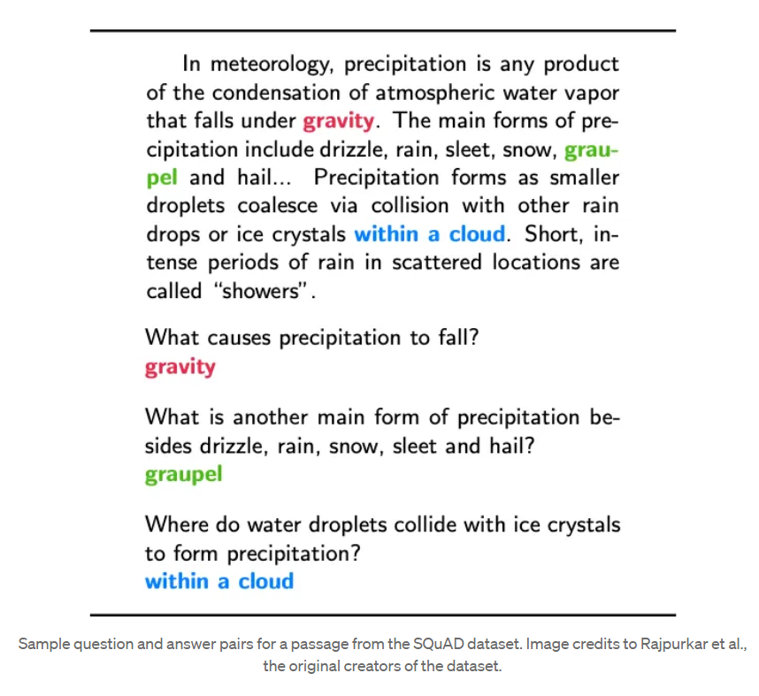
Intro: What can BART do?
SQuAD

Slide 5
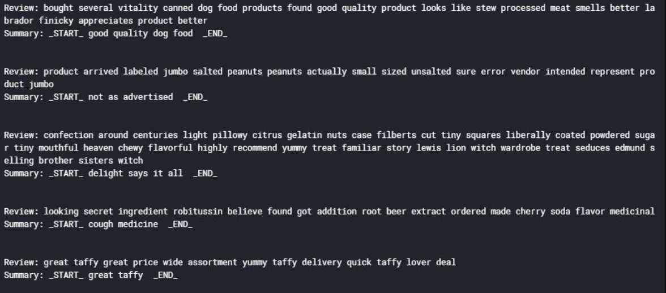
Intro: What can BART do?
Text Summerization:

Slide 6
Related Work
Transformer
BERT
GPT

Slide 7
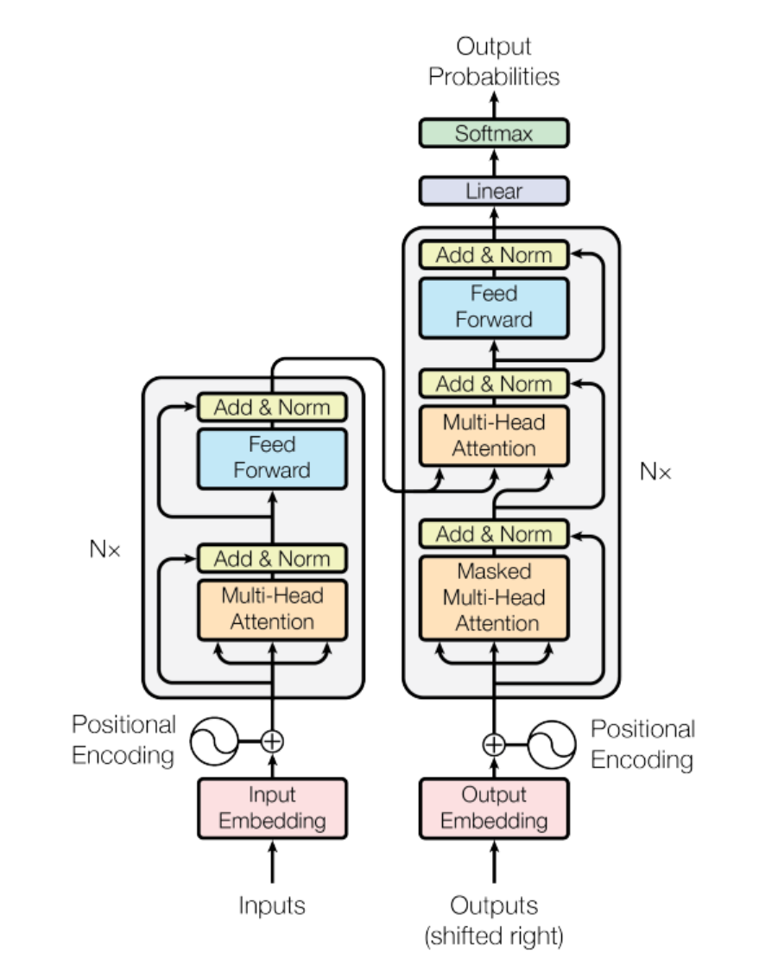
Related Work: Transformer
Introduced in 2017 in the famous paper
“Attention is all you Need”.
Stack of Encoder and Decoder blocks.
Encoder:
multi-headed self attention
bi-directional
Decoder:
masked self attention
left to right, uni-directional

Slide 8
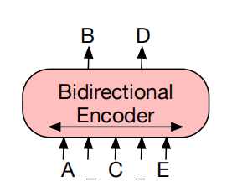
Related Work: BERT
Use Transformer Encoder
Pretrained with:
Masked language model
Next sentence prediction
Capture bi-directional context;
Good for comprehension tasks;
Bad for generation tasks

Slide 9
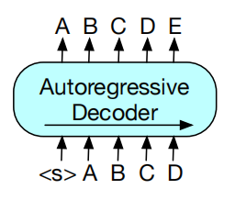
Related Work: GPT
Use Transformer Decoder
Auto-regressive
Uni-directional: left to right
Good for generation tasks

Slide 10
BART: Model Architecture
Standard seq2seq Transformer architecture with modification:
Use GeLUs activation instead of ReLU;
Initialize parameters from N(0, 0.02);
No feed-forward network before word prediction;
BART_base: 6 encoders + 6 decoders;
BART_large: 12 layers each

Slide 11
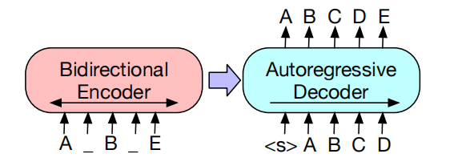
BART: Pre-training
The corrupted document (left) is encoded with a bidirectional model;
The likelihood of the original document (right) is calculated with an autoregressive decoder;
BART is trained by optimizing a reconstruction loss—the cross entropy between the decoder’s output and the original document.
Notes:
) BART: Inputs to the encoder need not be aligned with decoder outputs, allowing arbitary noise transformations. Here, a
document has been corrupted by replacing spans of text with mask symbols. The corrupted document (left) is encoded with
a bidirectional model, and then the likelihood of the original document (right) is calculated with an autoregressive decoder.
For fine-tuning, an uncorrupted document is input to both the encoder and decoder, and we use representations from the final
hidden state of the decoder.

Slide 12
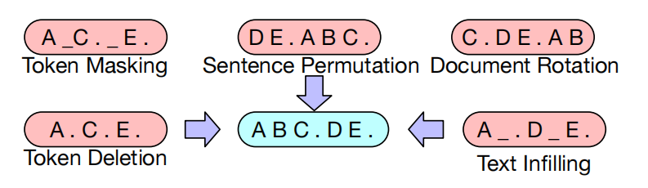
BART: Pre-training
Different types of document corruption:
Token Masking: Sample random tokens and replace them with [MASK] token;
Token Deletion: Delete random tokens from the input;
Text Infilling: Sample a span of text from Poisson distribution and replace this span of text with a single [MASK] token;
Sentence Permutation: Shuffle sentences in a random order;
Document Rotation: Choose a token uniformly at random, then rotate the document so taht it begins with that token.

Slide 13
BART: Fine-tuning
BART can be fine-tuned on a variety of downstream tasks:
Sequence Classification Task
Token Classification Tasks
Sequence Generation Tasks
Machine Translation Task

Slide 14
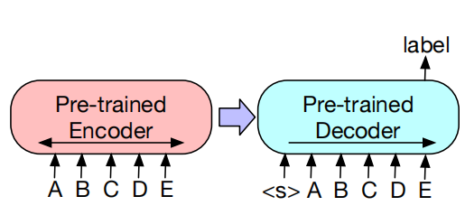
BART: Fine-tuning
Sequence Classification Task
The same input is fed into the encoder and decoder, and the final hidden state of the final decoder token is fed into new multi-class linear classifier.

Slide 15
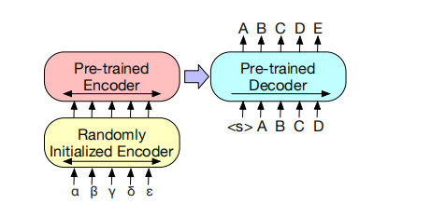
BART: Fine-tuning
Machine Translation Task
Replace BART’s encoder embedding layer with a new randomly initialized encoder;
Trains the new encoder to map foreign words into an input that BART
can de-noise to English.

Slide 16
Experiment: Comparing Pre-training Objectives
Compare BART with similar size pretrained models:
Language Model & Permuted Language Model
Masked Language Model & Multitask Masked Language Model
Masked Seq-to-Seq
Evalute on tasks:
Extractive question answering: SQuAD
Bitext classification task: MNLI
Generation task: ELI5, ConvAI2
Summerization Task: XSum, CNN/DM

Slide 17
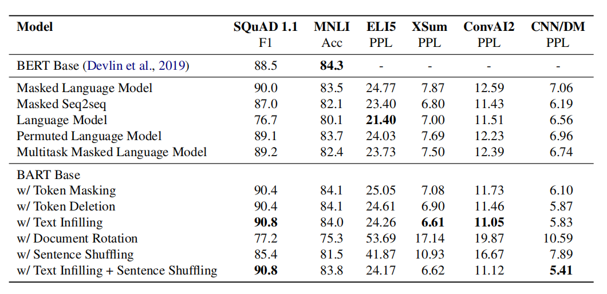
Experiment: Comparing Pre-training Objectives

Slide 18
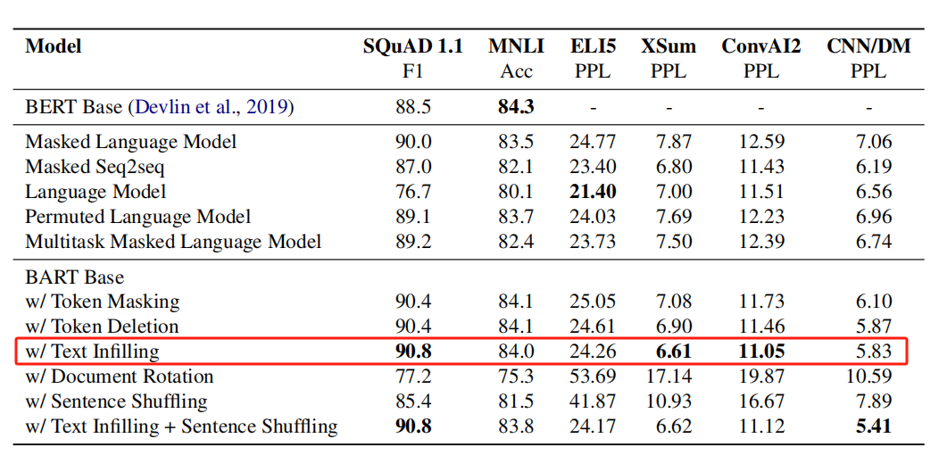
Observation 1: BART with text infilling performs best
BART models with text infilling demonstrate the most consistently strong performance.

Slide 19
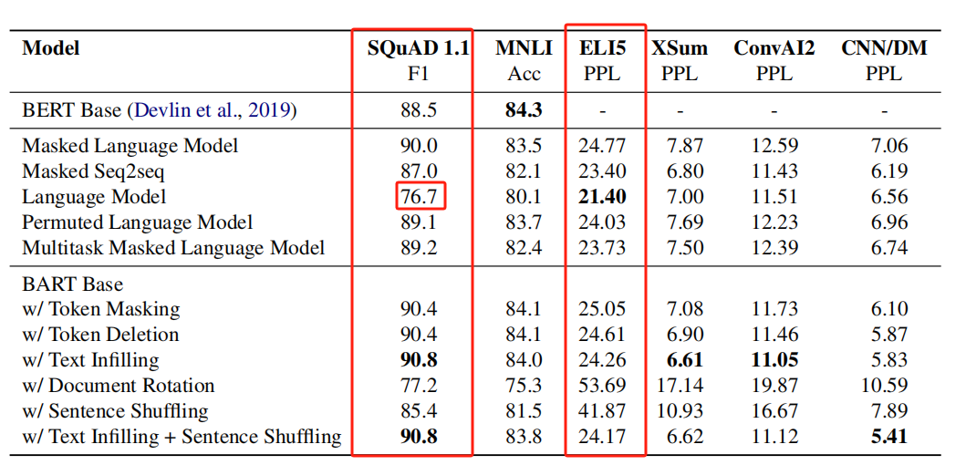
Observation 2: Performance varies considerably across tasks
Pure language models perform best on ELI5, while bidirectional encoders are crucial for SQuAD.

Slide 20
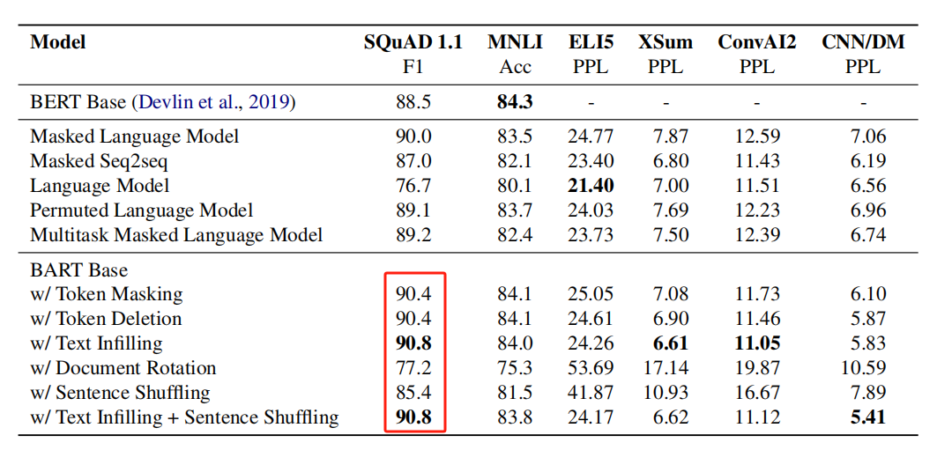
Observation 3: Token masking is crucial
Document rotation and sentence shuffling perform poorly in isolation. Successful methods invlove text infilling and token masking or deletion.
Observation 1:

Slide 21
Experiment: Large-scale Pre-training
Trained BART_large using the same scale as RoBERTa model and comapre it with similar size pretrained models.
12 layers in each of the encoder and decoder, and a hidden size of 1024.
Use a batch size of 8000, and train the model for 500,000 steps.
Pre-training data consists of 160Gb of news, books, stories, and web text.

Slide 22
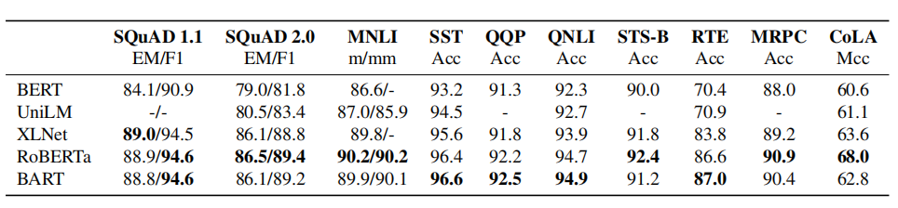
Obervation1: Discriminative Tasks
Below are results for large models on SQuAD and GLUE tasks.
BART performs comparably to RoBERTa and XLNet, suggesting that BART’s uni-directional decoder layers do not reduce performance on discriminative tasks.

Slide 23
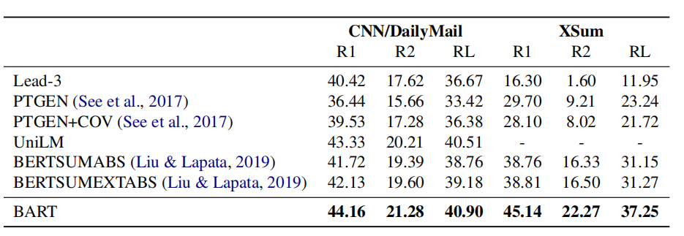
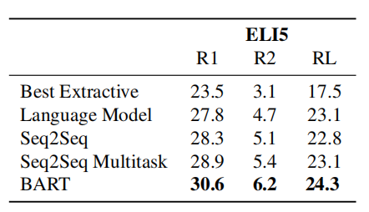
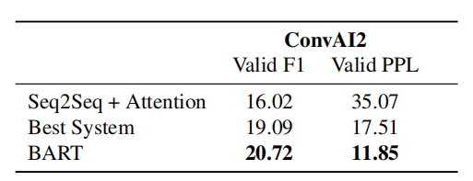
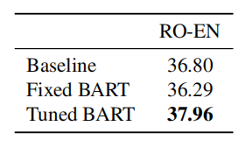
Obervation2: Generation Tasks
Generation tasks invlove summerization, dialogue, abstractive QA and translation. BART outperform existing models on all of these tasks.

Slide 24
References
1. BART: Denoising Sequence-to-Sequence Pre-training for Natural Language Generation, Translation, and Comprehension
2. Medium, BART Model Architecture, https://medium.com/@nadirapovey/bart-model-architecture-8ac1cea0e877
3. Hugging Face BART model and docs:
https://huggingface.co/models?sort=downloads&search=bart
https://huggingface.co/docs/transformers/model_doc/bart#overview

